Slide 1

Topics in Focus
Hemoglobinopathies

Slide 2

Topics in Focus
Hemoglobinopathies
Non-malignant hematology
Topics in Focus aims to increase access to innovative personalized diagnostics and treatment approaches to improve patients' lives through education and research, providing equitable access for patients and professionals across the EU and beyond.

Slide 3
Topics in Focus
EHA Grant’s types overview

Slide 4





Junior grant
Funding: €50,000/year for 3 years
Purpose: Support early-career researchers in basic or translational lab-based hematology research.
Advanced grant
Funding: €80,000/year for 3 years
Purpose: Support experienced researchers with a strong track record in lab-based hematology research
Funding: €80,000/year for 3 years
Purpose: Support MDs involved in patient care and lab-based research.
Eligibility: Must be within 8 years of PhD, MD, or hematology training completion, with at least 50% protected research time
Ph-scientist grant
Bilateral collab grant
Funding: €160,000/year for 2 years
Purpose: Support cross-border collab in basic or translational hematology research, lab-based.
Eligibility: At least one PI must be a junior independent group leader
Innovation grant
Funding: €300,000/year for 2 years
Purpose: Support collaborative, clinical or translational research in hematology.

Slide 5
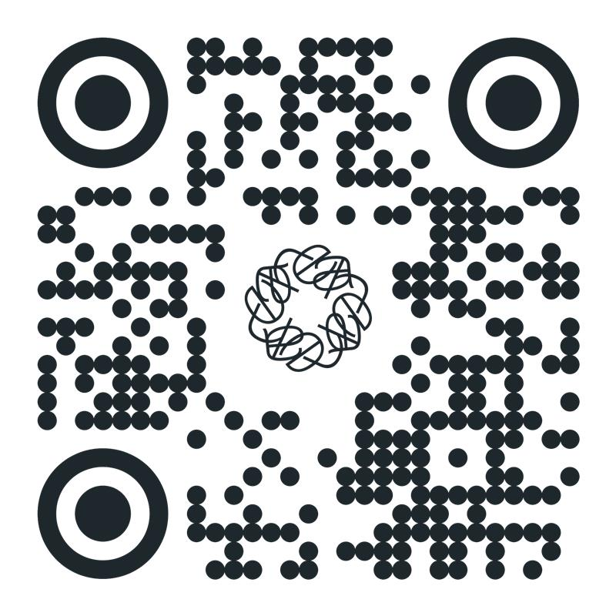
Learn more about EHA Research Grants opportunities.
Application deadline is October 14, 2025

